Slide 1

OPERATION
SHATTERED GLASS

Slide 2
The Laramie County Sheriff’s Office would like to thank the following agencies who assisted in making Operation Shattered Glass a huge success:
- Cheyenne Police Department Community Action Team (assigned to the DEA Task Force)
- Cheyenne Police Department Patrol Division
- Wyoming Division of Criminal Investigations Southeast and Southwest Enforcement Teams
- Wyoming Highway Patrol
- Laramie County Sheriff's Office Patrol Division
- Drug Enforcement Administration (Colorado and Wyoming)
- North Metro Drug Task Force (Colorado)
- Northern Colorado Drug Task Force (Colorado)
- Arapahoe County Sheriff’s Office (Colorado)
- Thornton Police Department (Colorado)
- Larimer County Sheriff’s Office (Colorado)
- Department of Homeland Security
- Laramie County District Attorney’s Office
- District of Wyoming United States Attorney’s Office
- District of Colorado United States Attorney’s Office

Slide 3
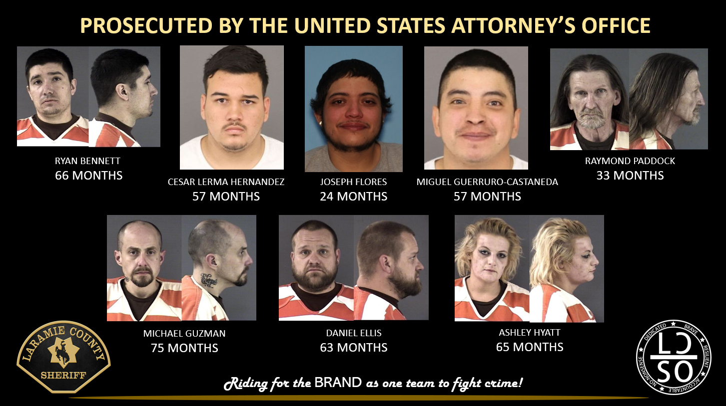

Slide 4
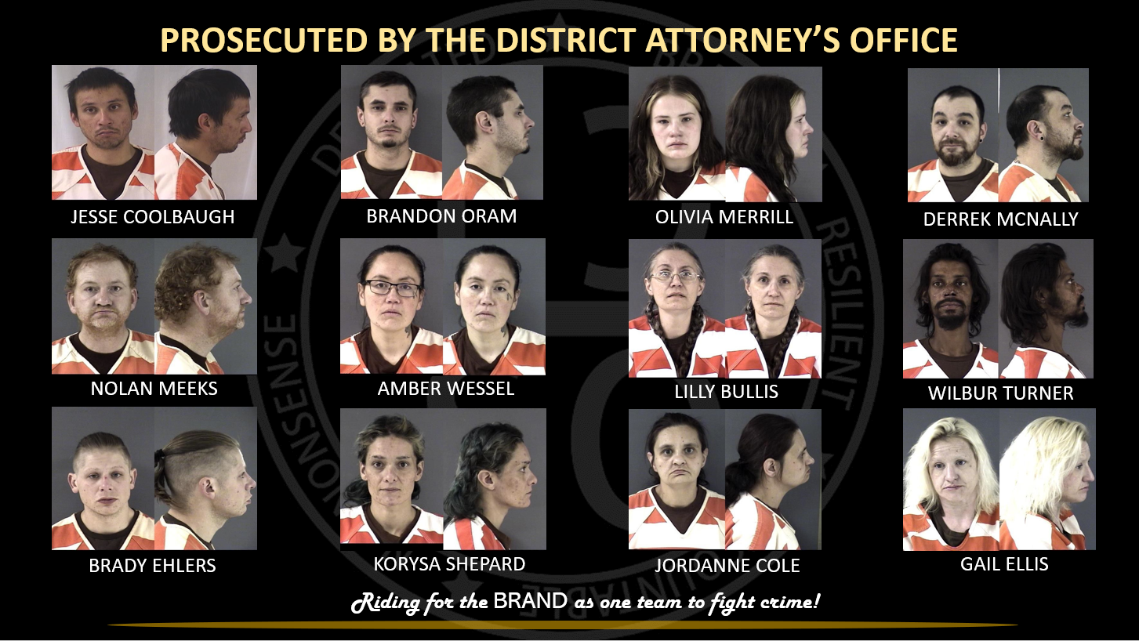

Slide 5
